Slide 1

Predictive Learning from Data
LECTURE SET 1
INTRODUCTION and OVERVIEW
Electrical and Computer Engineering

Slide 2
OUTLINE of Set 1
1.1 Overview: what is this course about
1.2 Prerequisites and Expected outcomes
1.3 Big Data and Scientific Discovery
1.4 Related Data Modeling Methodologies
1.5 Experimental Procedure (for predictive modeling)
1.6 Discussion: computer vs human intelligence

Slide 3
1.1 Overview
Uncertainty and Learning
Decision making under uncertainty
Biological learning (adaptation)
Epistemology: demonstrative inference vs. plausible (uncertain) inference
Induction in Statistics and Philosophy
Ex. 1: Many old men are bald
Ex. 2: Sun rises on the East every day

Slide 4
(cont’d) Many old men are bald
Psychological Induction:
- inductive statement based on experience
- also has certain predictive aspect
- no scientific explanation
Statistical View:
- the lack of hair = random variable
- estimate its distribution (depending on age) from past observations (training sample)
Philosophy of Science Approach:
- find scientific theory to explain the lack of hair
- explanation itself is not sufficient
- true theory needs to make non-trivial predictions

Slide 5
Conceptual Issues
Any theory (or model) has two aspects:
1. explanation of past data (observations)
2. prediction of future (unobserved) data
Achieving both goals perfectly not possible
Important issues to be addressed:
- quality of explanation and prediction
- is good prediction possible at all ?
- if two models explain past data equally well, which one is better?
- how to measure model complexity?

Slide 6
Beliefs vs. Scientific Theories
Men have lower life expectancy than women
Because they choose to do so
Because they make more money (on average) and experience higher stress managing it
Because they engage in risky activities
Because …..
Demarcation problem in philosophy

Slide 7
Philosophical Connections
From Oxford English dictionary:
Induction is the process of inferring a general law or principle from the observations of particular instances.
Clearly related to Predictive Learning.
All science and (most of) human knowledge involves (some form of) induction
How to form ‘good’ inductive theories?
→ inductive principles ~ general rules

Slide 8
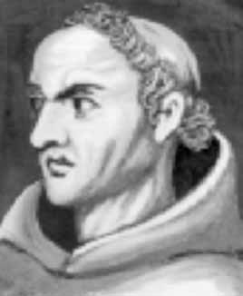
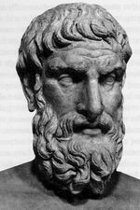
Philosophical Inductive Principles
William of Ockham: entities should not be multiplied beyond necessity
Epicurus of Samos: If more than one theory is consistent with the observations, keep all theories

Slide 9
Expected Outcomes + Prerequisites
Scientific / Technical:
Learning = generalization, concepts and issues
Math theory: Statistical Learning Theory aka VC-theory
Conceptual basis for various learning algorithms
Methodological:
How to use available statistical/machine learning/ data mining s/w
How to compare prediction accuracy of different learning algorithms
Are you getting good modeling results because you are smart or just lucky?
Practical Applications:
Financial engineering
Biomedical + Life Sciences
Security
Image recognition etc., etc.
What is this course NOT about

Slide 10
Grading
HOMEWORK ~ 40% (4 HW assignments)
Application of existing s/w to real-life and synthetic data sets
minor programming
emphasis on understanding underlying algorithms, experimental procedure and interpretation of results
COURSE PROJECT ~ 35%
Variety of topics, ranging from research to SW development
Individual Projects
List of possible topics will be posted on the web page this week
Student-initiated project topics are allowed subject to instructor’s approval
MIDTERM EXAM ~ 25%
Open book / Open notes
CLASS PARTICIPATION (extra credit) – up to 5%
I will occasionally ask open-ended questions during lectures

Slide 11
1.2 Prerequisites and Hwk1
Math: working knowledge of basic Probability + Linear Algebra
Introductory course on ML, i.e. EE4389W or CSci5525 or equiv. or consent of instructor
Statistical or machine learning software
- MATLAB, also R-project, Mathematica etc.
Note: you will be using s/w implementations of learning algorithms(not writing programs)
Software available on course website:
- Matlab-based for Windows

Slide 12
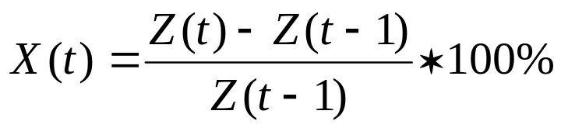
Homework 1 (background)
Purpose: testing background on probability + computer skills + common sense.
Modeling financial data from Yahoo! Finance
Real Data: X=daily price change of an index
i.e. where Z(t) = closing price
Is the stock market truly random?
Modeling assumption: price changes X are i.i.d.
→ leads to certain analytic relationship that can be verified using empirical data.

Slide 13
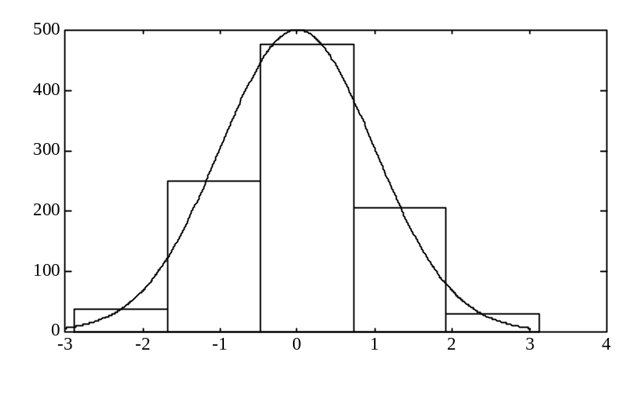
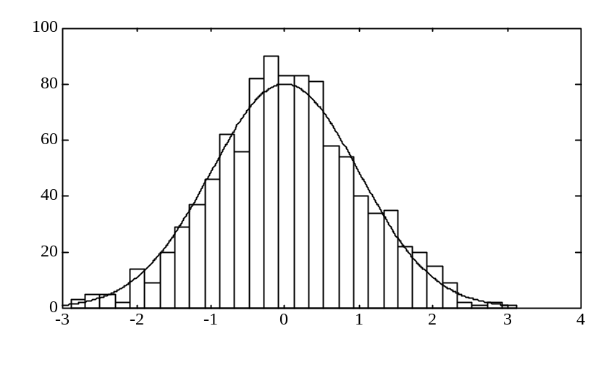
Understanding Daily Price Changes
Histogram = estimated pdf (from data)
Example: histograms of 5 and 30 bins to model N(0,1)
also mean and standard deviation (estimated from data)

Slide 14
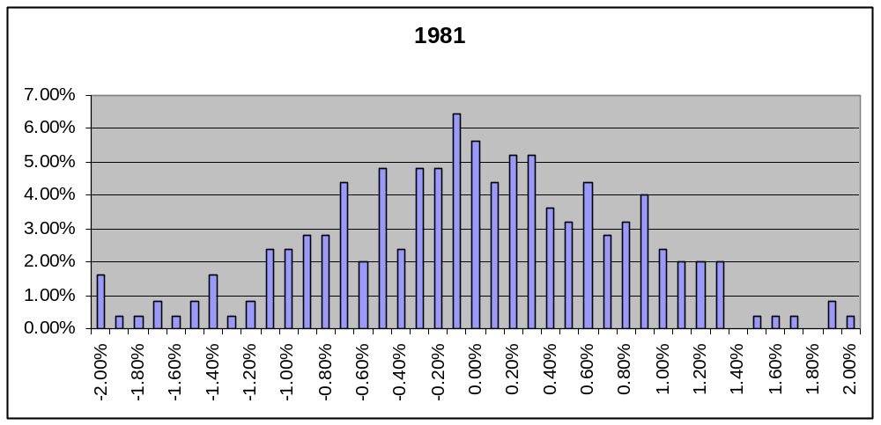
Histogram of daily price changes in 1981
NOTE: histogram ~ empirical pdf, i.e. scale of y-axis scale is in % (frequency).
Histogram of SP500 daily price changes in 1981:

Slide 15
OUTLINE of Set 1
1.1 Overview: what is this course about
1.2 Prerequisites and Expected outcomes
1.3 Big Data and Scientific Discovery
- scientific theories and fairy tales
- promise of Big Data
- characteristics of scientific knowledge
- dealing with uncertainty and risk
1.4 Related Data Modeling Methodologies
1.5 General Experimental Procedure
1.6 Discussion: Computer vs. Human intelligence

Slide 16
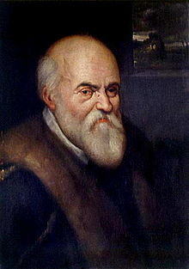

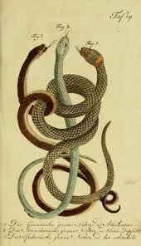
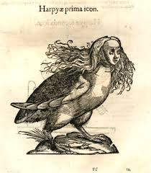
Historical Example
Ulisse Aldrovandi,16th century wrote
Natural History of Snakes

Slide 17
Promise of Big Data
Technical fairy tales in 21st century
~ marketing + more marketing
Promise of Big Data:
s/w program + DATA → knowledge
~ More Data → more knowledge
Yes-we-Can !

Slide 18
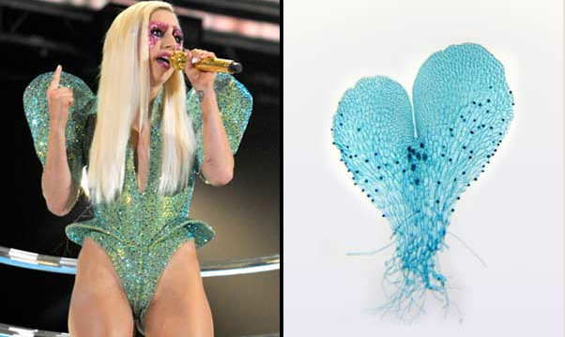
Examples from Life Sciences…
Duke biologists discovered an unusual link btwn the popular singer and a new species of fern, i.e.
- bisexual reproductive stage of the ferns;
- the team found the sequence GAGA when analyzing the fern’s DNA base pairs

Slide 19
Scientific Discovery
Combines ideas/models and facts/data
First-principle knowledge:
hypothesis → experiment → theory
~ deterministic, causal, intelligible models
Modern data-driven discovery:
s/w program + DATA → knowledge
~ statistical, complex systems
Many methodological differences

Slide 20
Invariants of Scientific Knowledge
Intelligent questions
Non-trivial predictions
Clear limitations/ constraints
All require human intelligence
- missing/ lost in Big Data?

Slide 21
Historical Example: Planetary Motions
How planets move among the stars?
- Ptolemaic system (geocentric)
- Copernican system (heliocentric)
Tycho Brahe (16 century)
- measure positions of the planets in the sky
- use experimental data to support one’s view
Johannes Kepler:
- used volumes of Tycho’s data to discover three remarkably simple laws

Slide 22

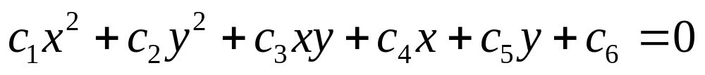
First Kepler’s Law
Sun lies in the plane of orbit, so we can represent positions as (x,y) pairs
An orbit is an ellipse, with the sun at a focus

Slide 23
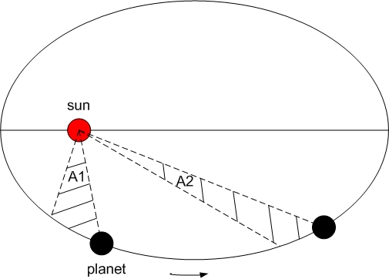
Second Kepler’s Law
The radius vector from the sun to the planet sweeps out equal areas in the same time intervals

Slide 24
Third Kepler’s Law
 | P | D | P² | D³
Mercury | 0.24 | 0.39 | 0.058 | 0.059
Venus | 0.62 | 0.72 | 0.38 | 0.39
Earth | 1.00 | 1.00 | 1.00 | 1.00
Mars | 1.88 | 1.53 | 3.53 | 3.58
Jupiter | 11.90 | 5.31 | 142.0 | 141.00
Saturn | 29.30 | 9.55 | 870.0 | 871.00
P = orbit period D = orbit size (half-diameter)
For any two planets: P² ~ D³

Slide 25
Empirical Scientific Theory
Kepler’s Laws can
- explain experimental data
- predict new data (i.e., other planets)
- BUT do not explain why planets move.
Popular explanation
- planets move because there are invisible angels beating the wings behind them
First-principle scientific explanation
Galileo and Newton discovered laws of motion and gravity that explain Kepler’s laws.

Slide 26
OUTLINE of Set 1
1.1 Overview: what is this course about
1.2 Prerequisites and Expected outcomes
1.3 Big Data and Scientific Discovery
1.4 Related Data Modeling Methodologies
- growth of empirical knowledge
- empirical vs first-principle knowledge
- handling uncertainty and risk
- related data modeling methodologies
1.5 General Experimental Procedure.

Slide 27
Scientific knowledge
Knowledge
~ stable relationships between facts and ideas (mental constructs)
Classical first-principle knowledge:
- rich in ideas
- relatively few facts (amount of data)
- simple relationships

Slide 28
Growth of empirical knowledge
Huge growth of the amount of data in 20th century (computers and sensors)
Complex systems (engineering, life sciences and social)
Classical first-principles science is inadequate for empirical knowledge
Need for new Methodology:
How to estimate good predictive models from noisy data?

Slide 29
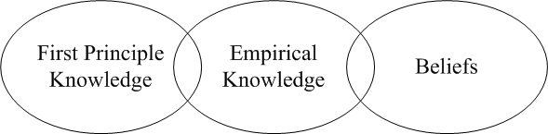
Different types of knowledge
Three types of knowledge
- scientific (first-principles, deterministic)
- empirical (uncertain, statistical)
- metaphysical (beliefs)
Boundaries are poorly understood

Slide 30
Handling Uncertainty and Risk(1)
Ancient times
Probability for quantifying uncertainty
- degree-of-belief
- frequentist (Cardano-1525, Pascale, Fermat)
Newton and causal determinism
Probability theory and statistics (20th century)
Modern classical science (A. Einstein)
Goal of science: estimating a true model or system identification

Slide 31
Handling Uncertainty and Risk(2)
Making decisions under uncertainty
~ risk management, adaptation, intelligence…
Probabilistic approach:
- estimate probabilities (of future events)
- assign costs and minimize expected risk
Risk minimization approach:
- apply decisions to known past events
- select one minimizing expected risk
Biological learning + complex systems

Slide 32
Summary
First-principles knowledge:
deterministic relationships between a few concepts (variables)
Importance of empirical knowledge:
- statistical in nature
- (usually) many input variables
Goal of modeling: to act/perform well, rather than system identification

Slide 33
Other Related Methodologies
Estimation of empirical dependencies is commonly addressed many fields
- statistics, data mining, machine learning, neural networks, signal processing etc.
- each field has its own methodological bias and terminology → confusion
Quotations from popular textbooks:
The field of Pattern Recognition is concerned with the automatic discovery of regularities in data.
Data Mining is the process of automatically discovering useful information in large data repositories.
Statistical Learning is about learning from data.
All these fields are concerned with estimating predictive models from data.

Slide 34
Other Methodologies (cont’d)
Generic Problem
Estimate (learn) useful models from available data
Methodologies differ in terms of:
- what is useful
- (assumptions about) available data
- goals of learning
Often these important notions are not well-defined.

Slide 35
Common Goals of Modeling
Prediction (Generalization)
Interpretation ~ descriptive model
Human decision-making using both above
Information retrieval, i.e. predictive or descriptive modeling of unspecified subset of available data
Note:
These goals usually ill-defined
Formalization of these goals in the context of application requirements is THE MOST IMPORTANT aspect of ‘data mining’

Slide 36
Three Distinct Methodologies (section 1.5)
Statistical Estimation
- from classical statistics and fct approximation
Predictive Learning (~ machine learning)
- practitioners in machine learning /neural networks
- Vapnik-Chervonenkis (VC) theory for estimating predictive models from empirical(finite) data samples
Data Mining
- exploratory data analysis, i.e. selecting a subset of available (large) data set with interesting properties

Slide 37
OUTLINE of Set 1
1.1 Overview: what is this course about
1.2 Prerequisites and Expected outcomes
1.3 Big Data and Scientific Discovery
1.4 Related Data Modeling Methodologies
1.5 General Experimental Procedure for Estimating Models from Data
1.6 Discussion: computer vs human intelligence

Slide 38
1.5 General Experimental Procedure
1. Statement of the Problem
2. Hypothesis Formulation (Problem Formalization) – different from classical statistics
3. Data Generation/ Experiment Design
4. Data Collection and Preprocessing
5. Model Estimation (learning)
6. Model Interpretation, Model Assessment and Drawing Conclusions
Note:
- each step is complex and requires several iterations
- estimated model depends on all previous steps
- observational data (not experimental_design)

Slide 39
Data Preprocessing and Scaling
Preprocessing is required with observational data (step 4 in general experimental procedure)
Examples: …
Basic preprocessing includes
- summary univariate statistics: mean, st. deviation, min + max value, range, boxplot performed independently for each input/output
- detection (removal) of outliers
- scaling of input/output variables (may be necessary for some learning algorithms)
Visual inspection of data is tedious but useful

Slide 40
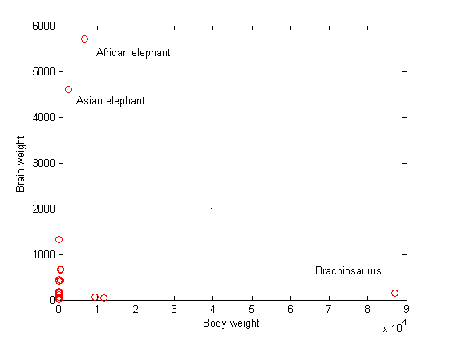
Original Unscaled Animal Data

Slide 41
Cultural + Ethical Aspects
Cultural and business aspects usually affect:
- problem formalization
- data access/ sharing (i.e., in life sciences)
- model interpretation
Examples: …
Possible solution approach
- to adopt common methodology
- critical for interdisciplinary projects

Slide 42
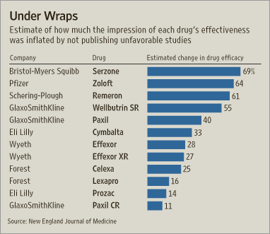
Honest Disclosure of Results
Recall Tycho Brahe + Kepler (16th century)
Modern drug studies
Review of studies submitted to FDA
• Of 74 studies reviewed, 38 were judged to be positive by the FDA. All but one were published.
• Most of the studies found to have negative or questionable results were not published.
Source: The New England Journal of Medicine, WSJ Jan 17, 2008)
Publication bias: common in modern research

Slide 43
Topic for Discussion
Read the paper by Ioannidis (2005) about the danger of self-serving data analysis. Explain how the general experimental procedure can help to safeguard against such biased data modeling. Then give a specific example of a recent misleading research finding based on incorrect interpretation of data. Try to come up with an example from your own application domain (i.e., the technical field you are interested in/ or working in).
Ioannidis (2005) paper is available on-line at
http://www.plosmedicine.org/article/info:doi/10.1371/journal.pmed.0020124

Slide 44
OUTLINE of Set 1
1.1 Overview: what is this course about
1.2 Prerequisites and Expected outcomes
1.3 Big Data and Scientific Discovery
1.4 Related Data Modeling Methodologies
1.5 Experimental Procedure (for predictive modeling)
1.6 Discussion: computer vs human intelligence

Slide 45
Human vs Computer Intelligence
Human/ biological brain good for:
- visual recognition/ pattern recognition
- natural language understanding
- complex environment (~ driving a car)
Digital computers good for:
- storing/ manipulating large amounts of data
- mathematically well-defined problems
machine intelligence ~ solving ill-posed problems
Caveat: computer intelligence usually means imitating human intelligence, not understanding it

Slide 46
Some Examples
Computers can be programmed to do well:
- play chess
- fly commercial airplane
Example of natural language understanding:
Original: Cheese eating surrender monkeys
Computer Translation to French: Primates capitulars et toujours en quete de fromages
Back to English: Primates who capitulate and who are constantly in search of cheese
Common misunderstanding: Turing test

Slide 47
Growth of Technology vs Knowledge
Two problems in history of human knowledge
(1) How to store+disseminate human knowledge
(2) How to create new knowledge
Digital Technology solves Problem (1) very well.
But can technology help to generate knowledge?
Where does knowledge come from?
Central problem in Philosophy of Science:
Idealism ~ knowledge comes from human mind
vs. Materialism ~ from observations of Nature
Modern variant of naïve materialism ~ Big Data

Slide 48
Many Discussions in Mass Media
Some representative articles on AI+ML:
by Y. Harari: https://www.theatlantic.com/magazine/archive/2018/10/yuval-noah-harari-technology-tyranny/568330/
by H. Kissinger: https://www.theatlantic.com/magazine/archive/2018/06/henry-kissinger-ai-could-mean-the-end-of-human-history/559124/
These articles usually discuss:
doomsday future with AI dominating humans
written by authors lacking any technical knowledge
Many strange assumptions, such as:
“AI establishes its own goals”

